Slide 1

Introduction to ML strategy
Why ML
Strategy?
deeplearning.ai

Slide 2
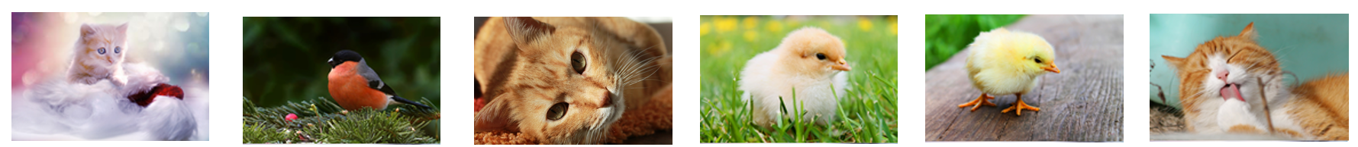
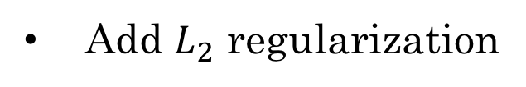

Motivating example
Ideas:
Collect more data
Try dropout
Collect more diverse training set
Add $L_{2}$ regularization
Train algorithm longer with gradient descent
Network architecture
Try Adam instead of gradient descent
Activation functions
Try bigger network
# hidden units
Try smaller network
…

Slide 3
Introduction to ML strategy
Orthogonalization
deeplearning.ai

Slide 4
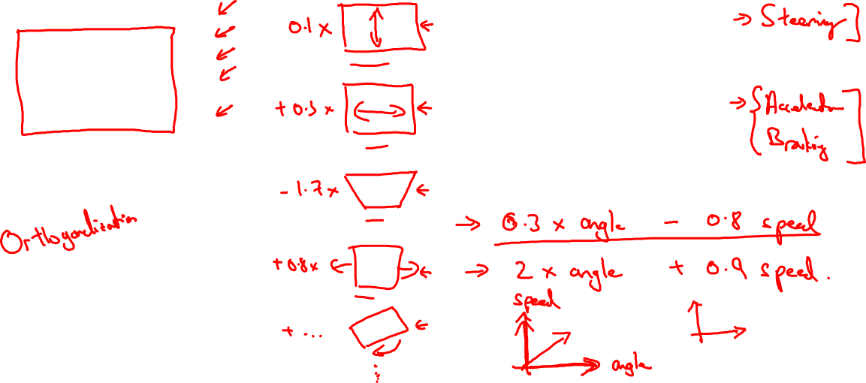
TV tuning example
Car

Slide 5
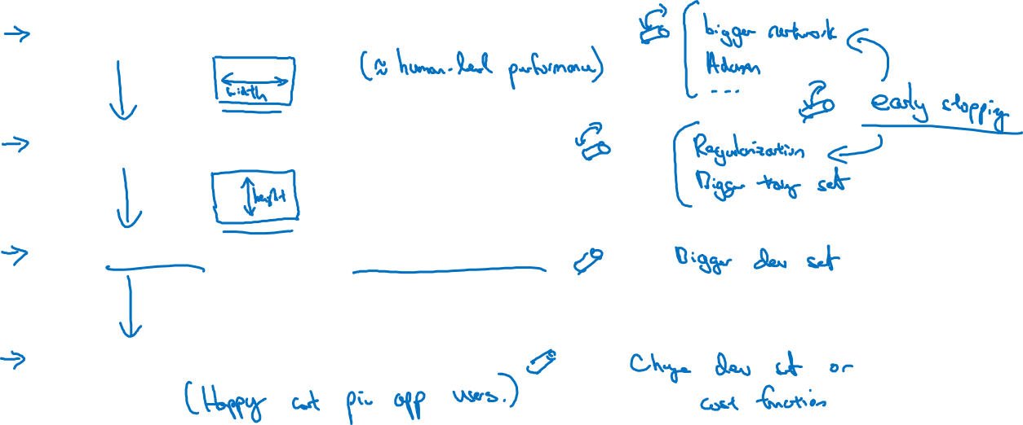
Chain of assumptions in ML
Fit training set well on cost function
Fit dev set well on cost function
Fit test set well on cost function
Performs well in real world

Slide 6
Setting up your goal
Single number
evaluation metric
deeplearning.ai

Slide 7

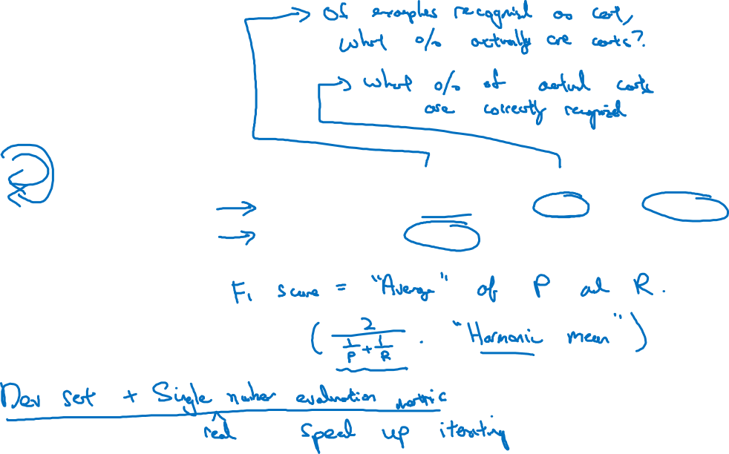
Using a single number evaluation metric
Idea
Classifier | Precision | Recall | F1 Score
A | 95% | 90% | 92.4%
B | 98% | 85% | 91.0%
Experiment
Code

Slide 8
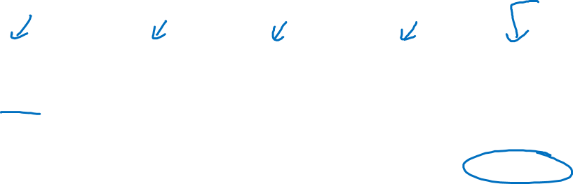
Another example
Algorithm | US | China | India | Other | Average
A | 3% | 7% | 5% | 9% | 6%
B | 5% | 6% | 5% | 10% | 6.5%
C | 2% | 3% | 4% | 5% | 3.5%
D | 5% | 8% | 7% | 2% | 5.25%
E | 4% | 5% | 2% | 4% | 3.75%
F | 7% | 11% | 8% | 12% | 9.5%

Slide 9
Setting up your goal
Satisficing and
optimizing metrics
deeplearning.ai

Slide 10
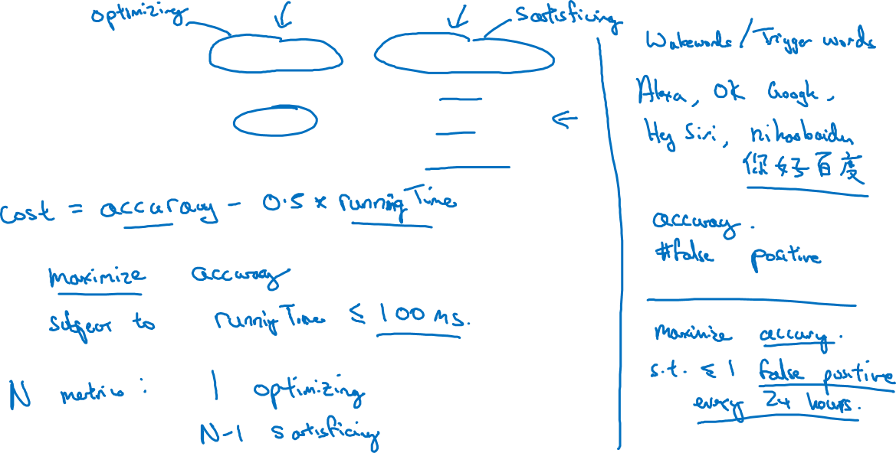
Another cat classification example
Classifier | Accuracy | Running time
A | 90% | 80ms
B | 92% | 95ms
C | 95% | 1,500ms

Slide 11
Setting up your goal
Train/dev/test
distributions
deeplearning.ai

Slide 12
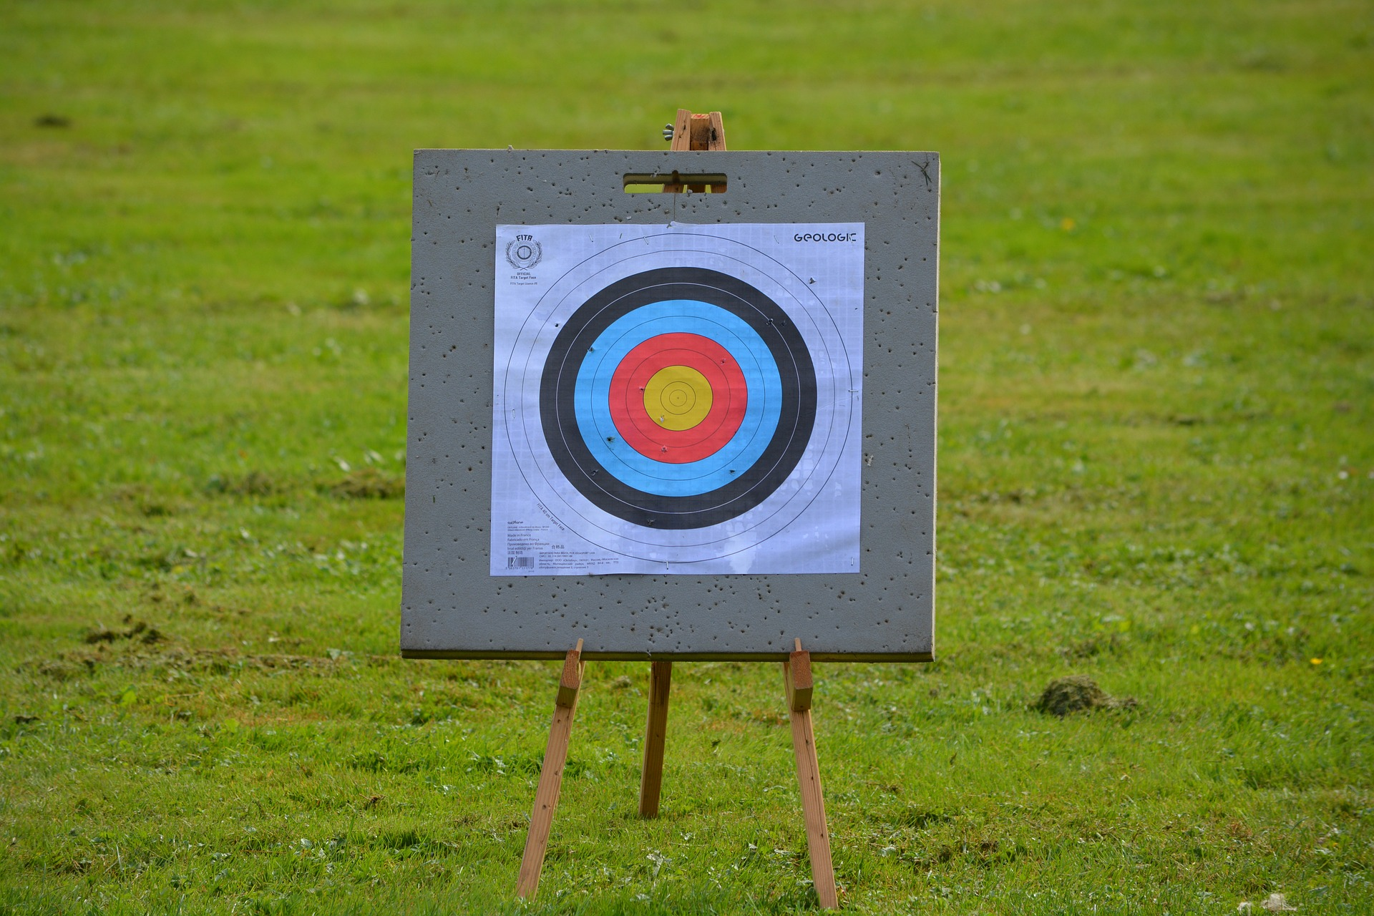
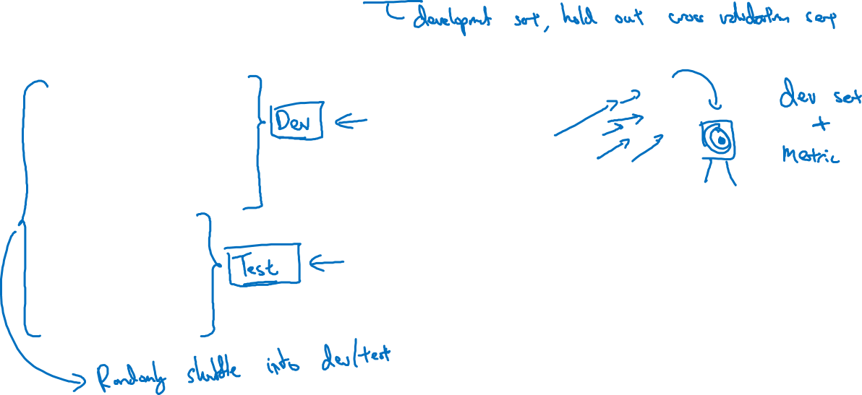
Cat classification dev/test sets
Regions:
US
UK
Other Europe
South America
India
China
Other Asia
Australia
Idea
Experiment
Code

Slide 13
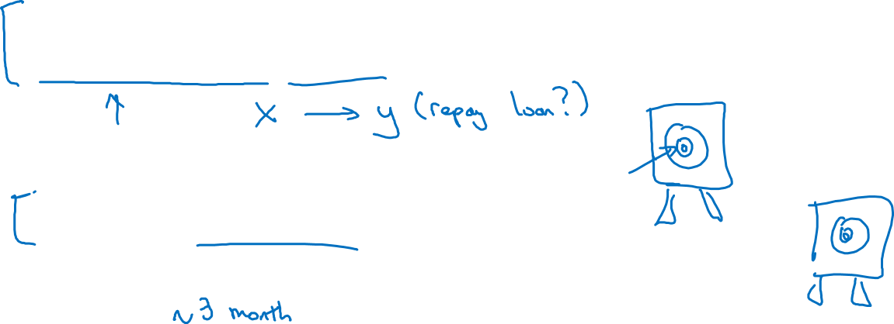
True story (details changed)
Optimizing on dev set on loan approvals for medium income zip codes
Tested on low income zip codes

Slide 14
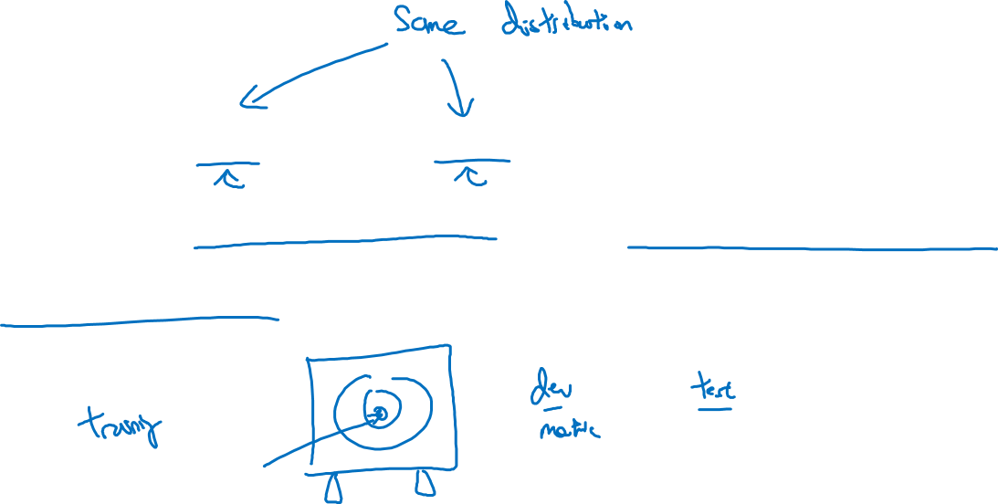
Guideline
Choose a dev set and test set to reflect data you
expect to get in the future and consider important
to do well on.

Slide 15
Setting up your goal
Size of dev
and test sets
deeplearning.ai

Slide 16
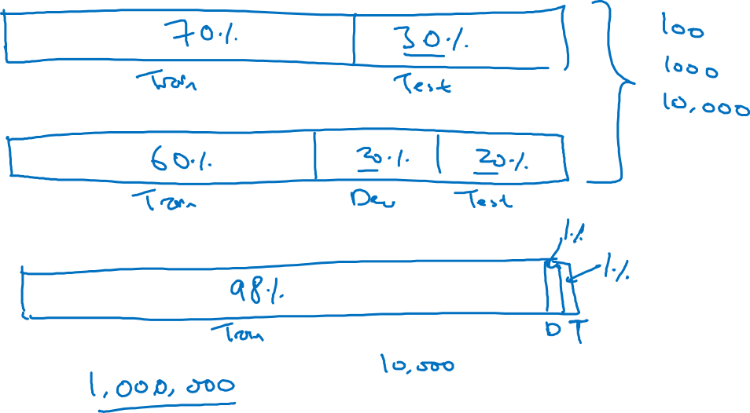
Old way of splitting data

Slide 17
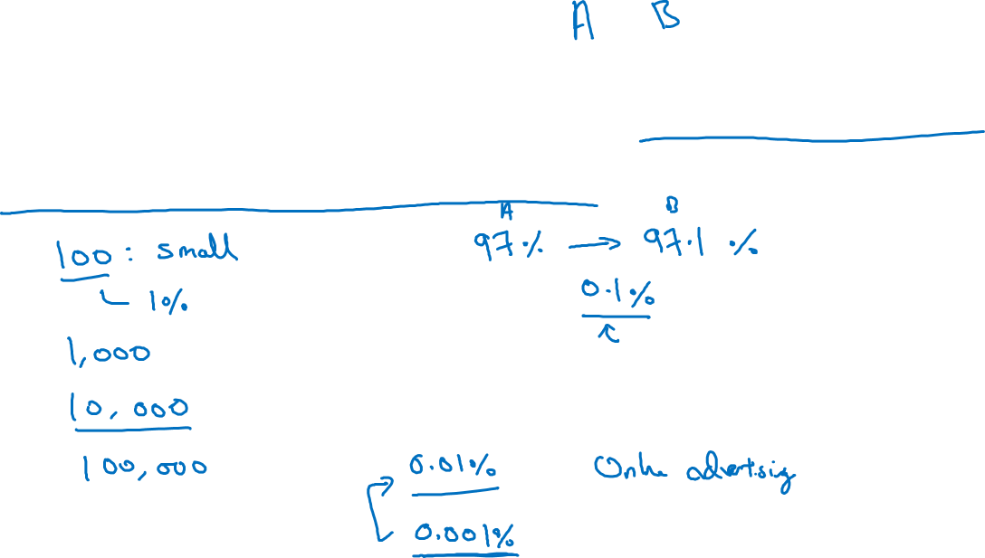
Size of dev set
Set your dev set to be big enough to detect differences in
algorithm/models you’re trying out.

Slide 18
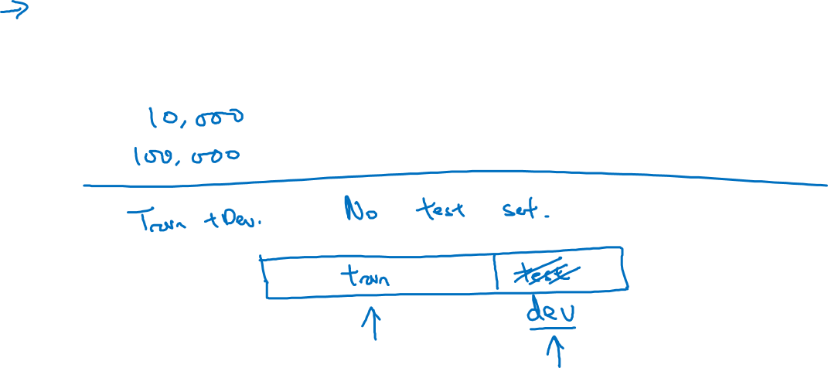
Size of test set
Set your test set to be big enough to give high confidence
in the overall performance of your system.

Slide 19
Setting up your goal
When to change
dev/test sets and
metrics
deeplearning.ai

Slide 20
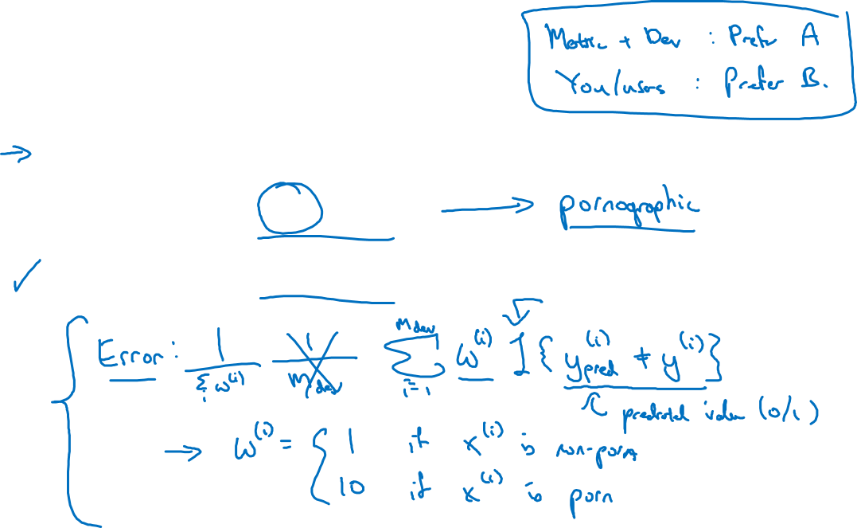
Cat dataset examples
Metric: classification error
Algorithm A: 3% error
Algorithm B: 5% error

Slide 21
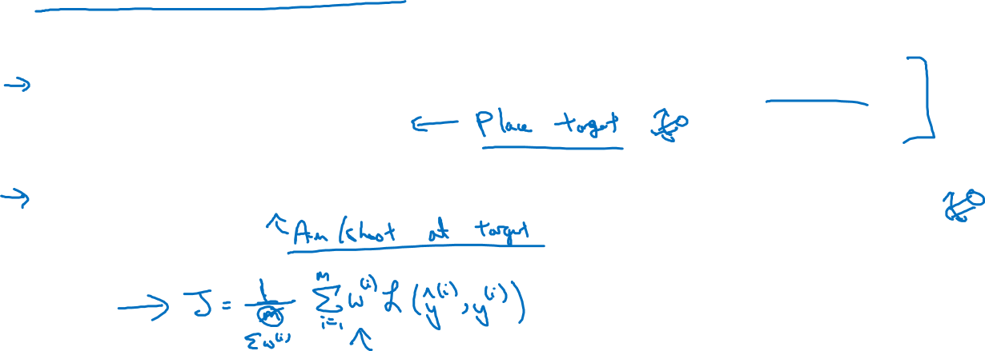
Orthogonalization for cat pictures: anti-porn
So far we’ve only discussed how to define a metric to evaluate classifiers.
2. Worry separately about how to do well on this metric.

Slide 22
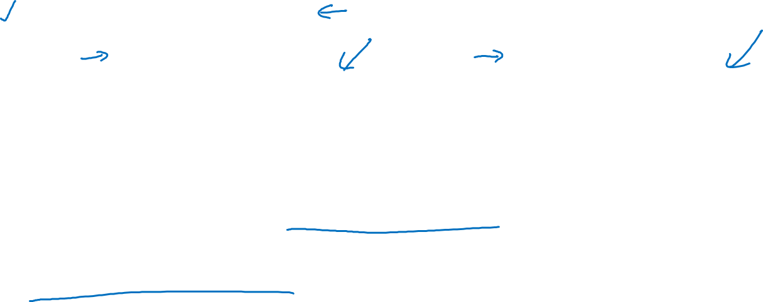
Another example
Algorithm A: 3% error
Algorithm B: 5% error
Dev/test
User images
If doing well on your metric + dev/test set does not
correspond to doing well on your application, change your
metric and/or dev/test set.

Slide 23
Comparing to human-level performance
Why human-level
performance?
deeplearning.ai

Slide 24
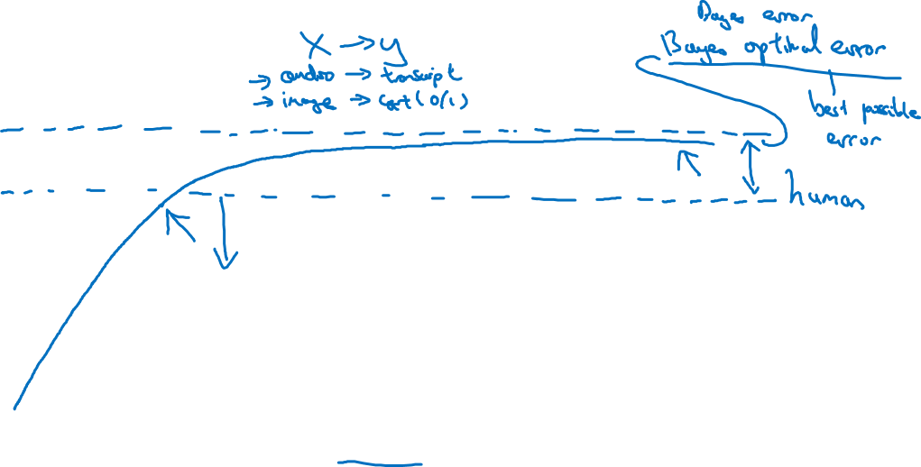
Comparing to human-level performance
accuracy
time

Slide 25
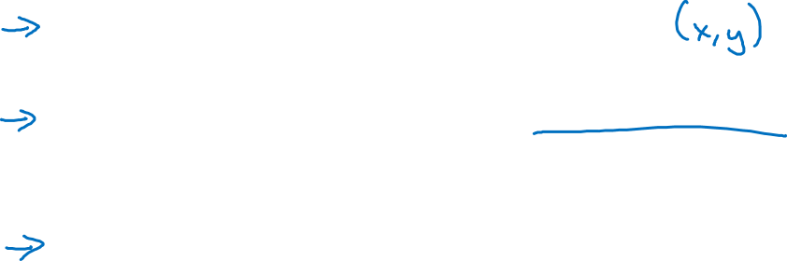
Why compare to human-level performance
Humans are quite good at a lot of tasks. So long as ML is worse than humans, you can:
Get labeled data from humans.
Gain insight from manual error analysis: Why did a person get this right?
Better analysis of bias/variance.

Slide 26
Comparing to human-level performance
Avoidable bias
deeplearning.ai

Slide 27
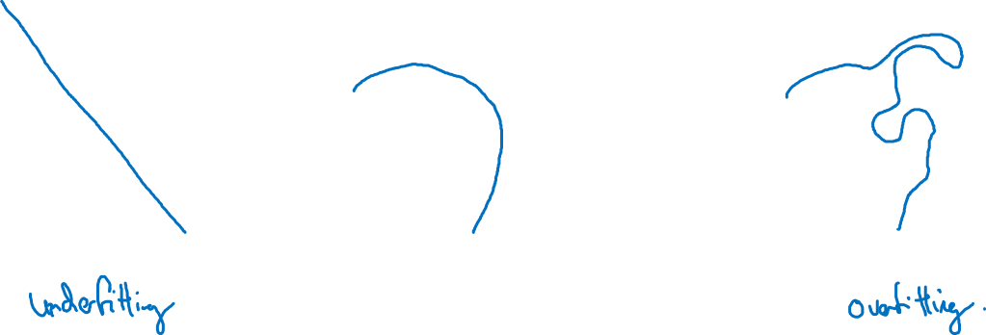
Bias and Variance
high bias
“just right”
high variance

Slide 28
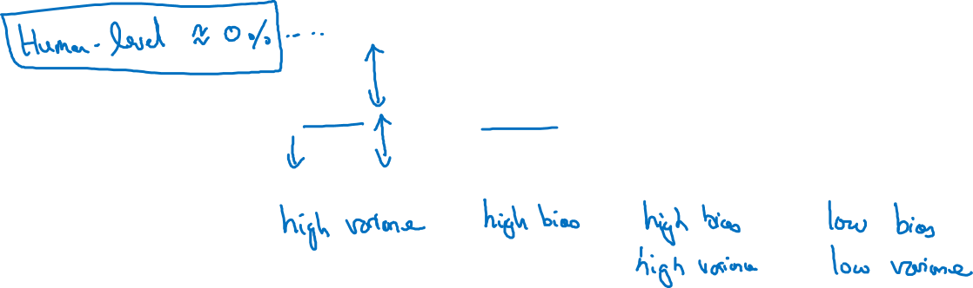
Bias and Variance
Cat classification
Training set error: 1% 15% 15% 0.5%
Dev set error: 11% 16% 30% 1%

Slide 29
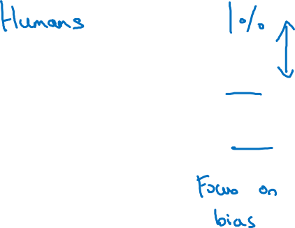
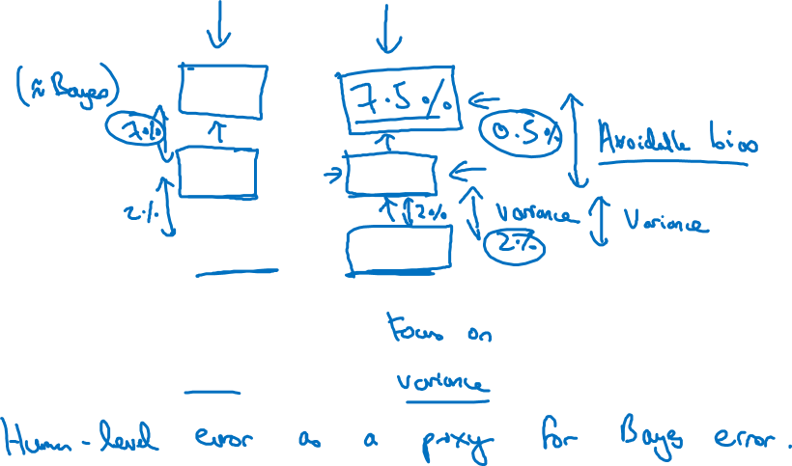
Cat classification example
Training error 8%
8 %
Dev error 10%
10 %

Slide 30
Comparing to human-level performance
Understanding human-level performance
deeplearning.ai

Slide 31
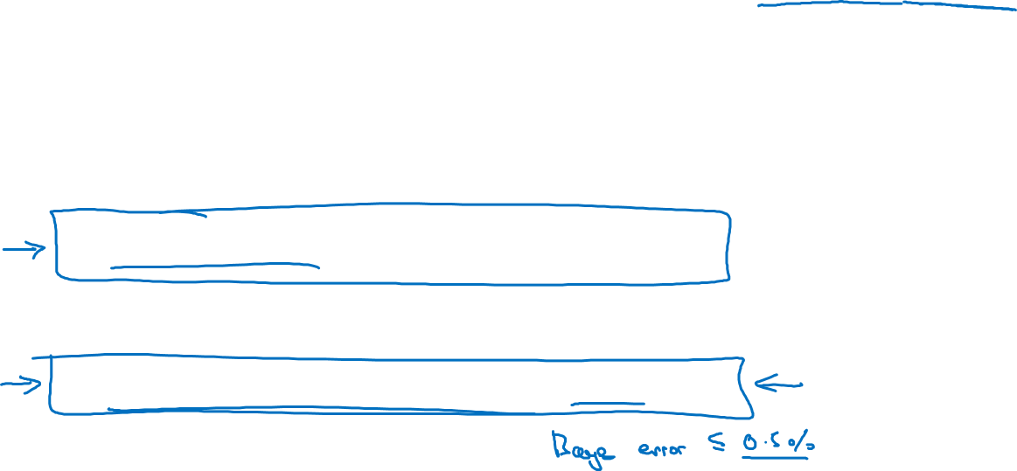
Human-level error as a proxy for Bayes error
Medical image classification example:
Suppose:
(a) Typical human ………………. 3 % error
(b) Typical doctor ………………... 1 % error
(c) Experienced doctor …………... 0.7 % error
(d) Team of experienced doctors .. 0.5 % error
What is “human-level” error?

Slide 32
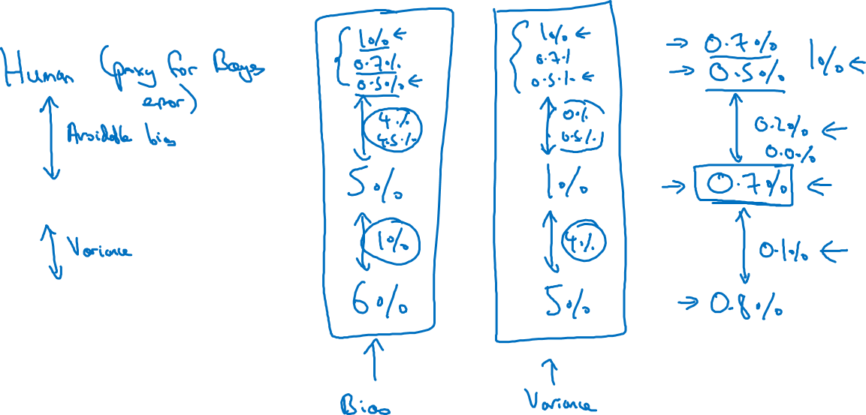
Error analysis example
Training error
Dev error

Slide 33
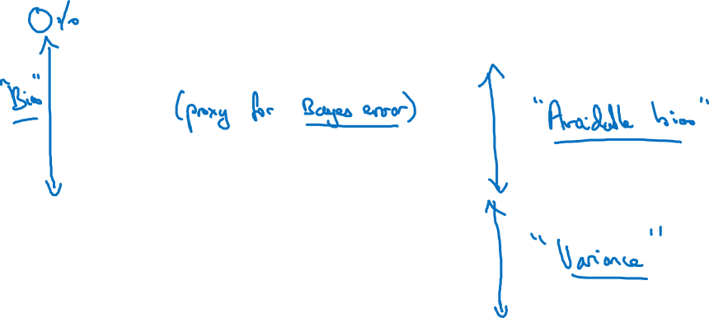
Summary of bias/variance with human-level performance
Human-level error
Training error
Dev error

Slide 34
Comparing to human-level performance
Surpassing human- level performance
deeplearning.ai

Slide 35
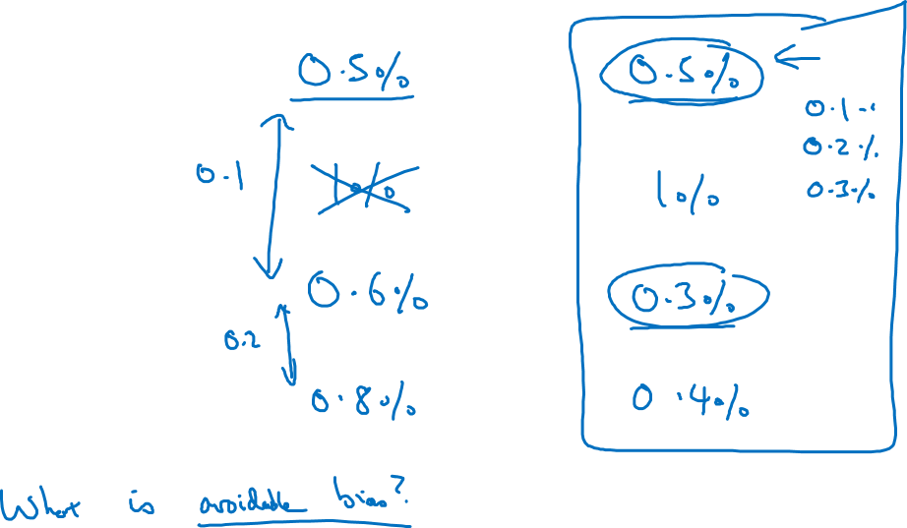
Surpassing human-level performance
Team of humans
One human
Training error
Dev error

Slide 36
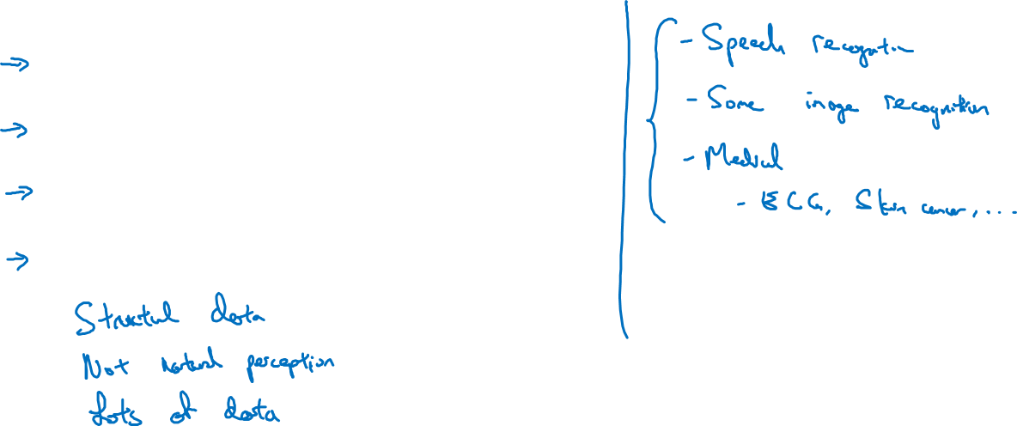
Problems where ML significantly surpasses human-level performance
Online advertising
Product recommendations
Logistics (predicting transit time)
Loan approvals

Slide 37
Comparing to human-level performance
Improving your model
performance
deeplearning.ai

Slide 38
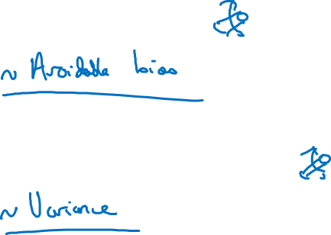
The two fundamental assumptions of supervised learning
1. You can fit the training set pretty well.
2. The training set performance generalizes pretty
well to the dev/test set.

Slide 39
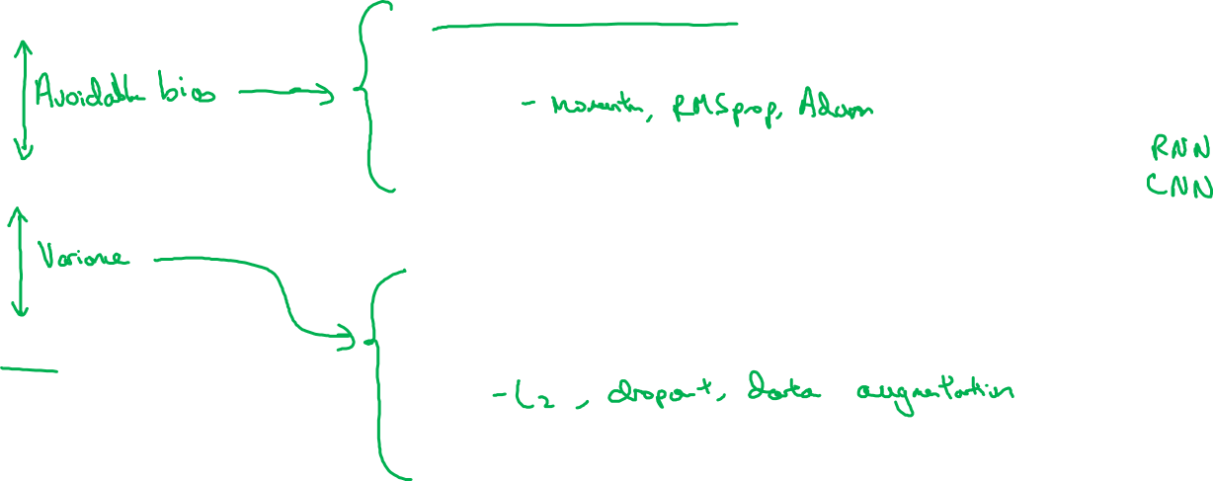
Reducing (avoidable) bias and variance
Human-level
Train bigger model
Train longer/better optimization algorithms
Training error
NN architecture/hyperparameters search
More data
Dev error
Regularization
NN architecture/hyperparameters search

